Slide 1
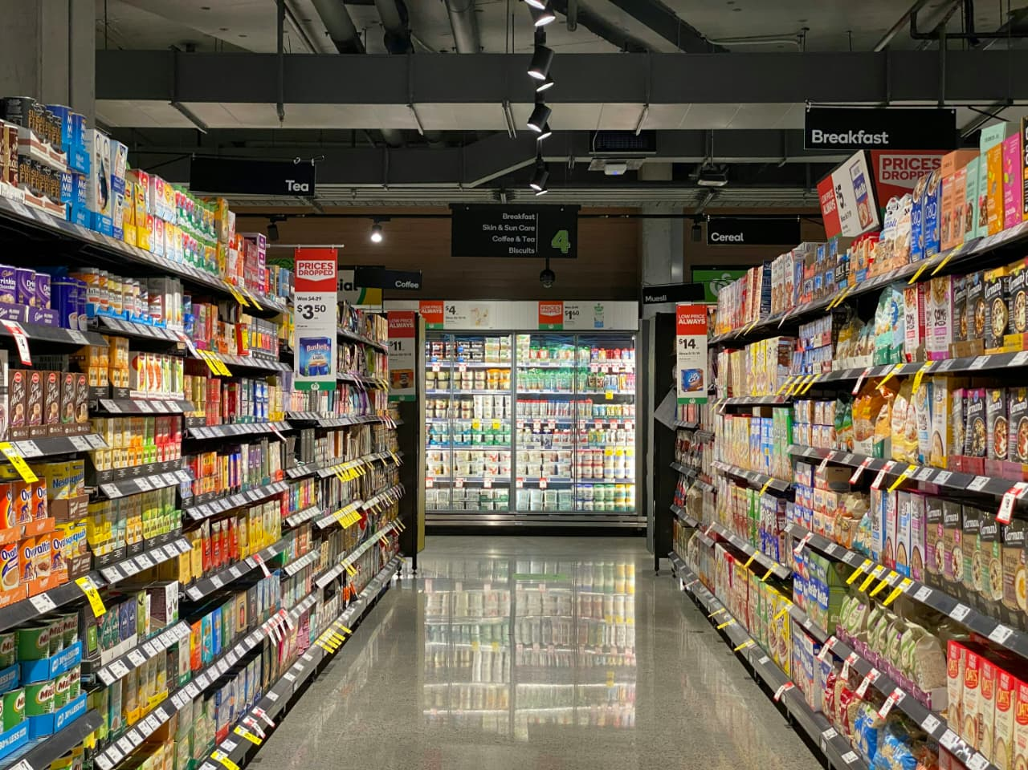

`
Grocery Store Management

Slide 2
About me
Background:
Bachelor of Technology in Artificial Intelligence and Machine Learning.
Why you want to learn Data Analytics?
I want to learn Data Science to analyze real-world data, discover hidden patterns, and make data-driven decisions that create meaningful impact.
Any work experience?
NO
Share your LinkedIn and GitHub profile URLs:
Linkedln: https://linkedin.com/in/poojitha-thatavarthi-556965290
Github : https://github.com/thatavarthi321

Slide 3
Agenda
Objective of the Project
ER Diagram and schema explanation
Key analysis questions
SQL query results
Final business insights and recommendations
Conclusion
Experience/Challenges

Slide 4
Objective of the Project
To design and implement a relational database for managing a grocery store efficiently.
To organize and store information about customers, employees, products, suppliers, categories, and orders in a structured way.
To identify business insights such as best-selling products, top customers, revenue trends, and supplier contributions.
To practice applying joins, subqueries, aggregations, and filtering techniques for solving real-world problems.
To support decision-making by providing clear and actionable recommendations based on data analysis.

Slide 5
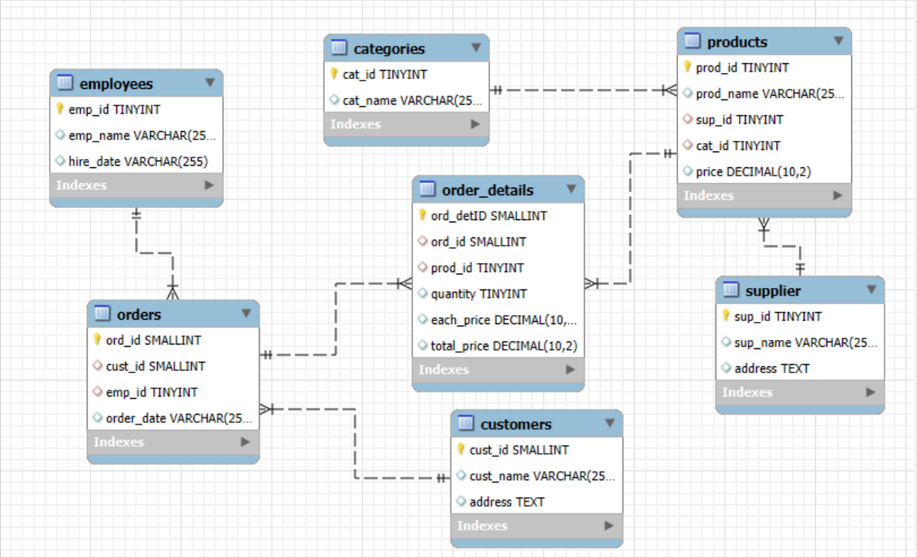
ER Diagram and Schema Explanation

Slide 6
Entities & Relationships
Suppliers → Products (One-to-Many): Each supplier can provide many products.
Categories → Products (One-to-Many): Each category contains multiple products.
Products → Order_Details (One-to-Many): A product can appear in many order details.
Orders → Order_Details (One-to-Many): An order can have multiple line items.
Customers → Orders (One-to-Many): A customer can place multiple orders.
Employees → Orders (One-to-Many): An employee can process multiple orders.

Slide 7
Supplier
Stores supplier details such as name and address.
Primary Key: sup_id
Linked to Products.
Categories
Contains different product categories (e.g., Beverages, Snacks).
Primary Key: cat_id
Linked to Products.
Products
Holds product details including name, price, category, and supplier.
Primary Key: prod_id
Foreign Keys:
sup_id → Supplier.sup_id
cat_id → Categories.cat_id
Linked to Order_Details.

Slide 8
Customers
Stores customer information such as name and address.
Primary Key: cust_id
Linked to Orders.
Employees
Records employee details who handle customer orders (e.g., name, hire_date).
Primary Key: emp_id
Linked to Orders.
Orders
Logs order information including customer, employee, and date.
Primary Key: ord_id
Foreign Keys:
cust_id → Customers.cust_id
emp_id → Employees.emp_id
Linked to Order_Details.

Slide 9
Order_Details
Stores individual items for each order such as quantity, unit price, and total price.
Primary Key: ord_detID
Foreign Keys:
ord_id → Orders.ord_id
prod_id → Products.prod_id

Slide 10
Key Analysis Questions
Who are the top 5 customers by total purchase amount?
Which products have the highest sales volume (by quantity)?
What are the monthly trends in order volume and revenue?
What is the average price of products from each supplier?
Which employees have handled the most orders?
What is the average quantity ordered per product?

Slide 11
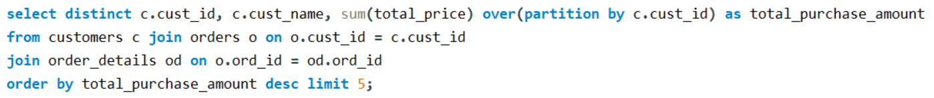
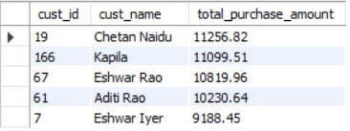
SQL Query Results

Slide 12
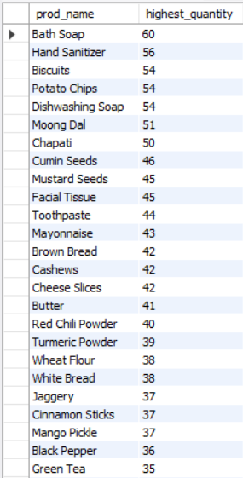
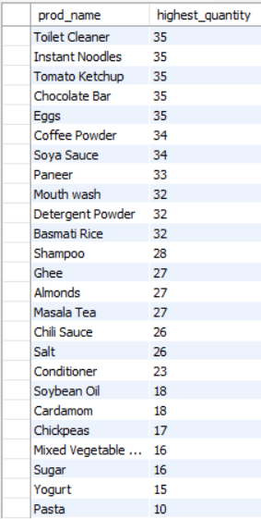

Slide 13
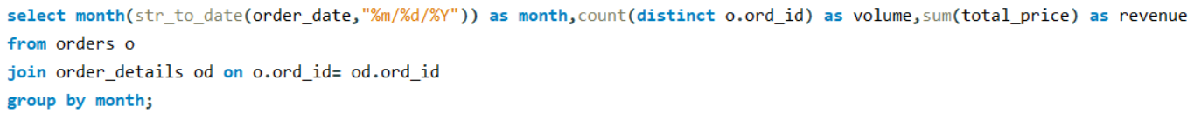
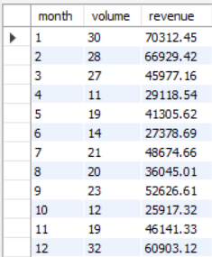

Slide 14
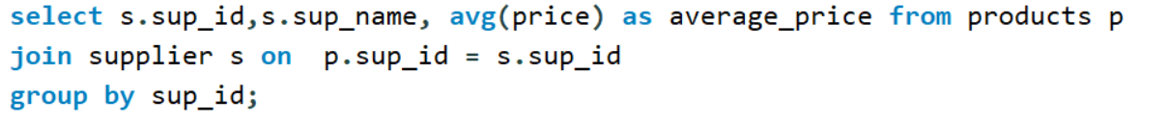
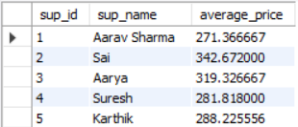

Slide 15
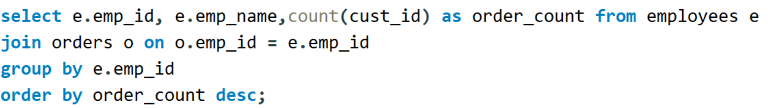
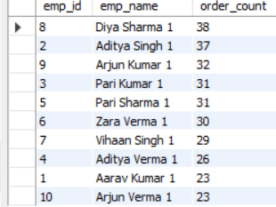

Slide 16
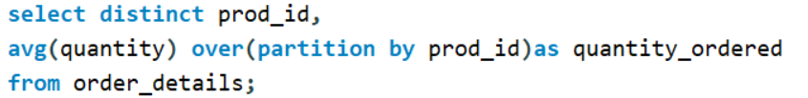
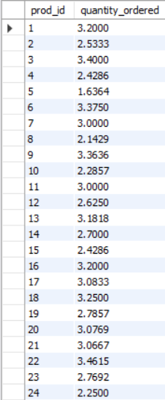
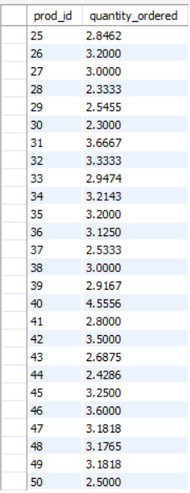

Slide 17
Final Business Insights and Recommendations
Customer data shows a small set of loyal buyers contribute a major share of revenue → focus on customer retention programs.
Product analysis reveals best-sellers in specific categories → increase stock and promotions for top-performing products.
Supplier contribution highlights certain vendors as key revenue drivers → negotiate better terms and maintain strong relationships with them.
Employee performance data shows variations in order handling → offer training and incentives to underperforming staff.
Sales trend analysis indicates peak times/months → plan seasonal promotions and optimize inventory accordingly.

Slide 18
Conclusion
The grocery store database successfully supports analysis across customers, products, suppliers, and employees.
Data insights highlight top customers, best-selling products, and high-value suppliers.
Sales and revenue trends provide clear guidance for inventory planning and business strategy
The project proves that SQL-based data analysis can drive informed decision-making in retail operations.

Slide 19
Experience/Challenges
Understanding relationships between multiple tables and applying correct joins.
Handling aggregations and subqueries across large datasets.
Learning to transform raw SQL outputs into meaningful business insights.
Overall, the project improved confidence in SQL, problem-solving, and analytical thinking.

Slide 20

THANK YOU

